Slide 1
Pillow 기본 명령어 활용 13주차_01_02
한 동 대 학 교 김경미 교수

Slide 2
학습목표
Pillow 다양한 기능 익히기
Pillow 다양한 기능 활용하기

Slide 3
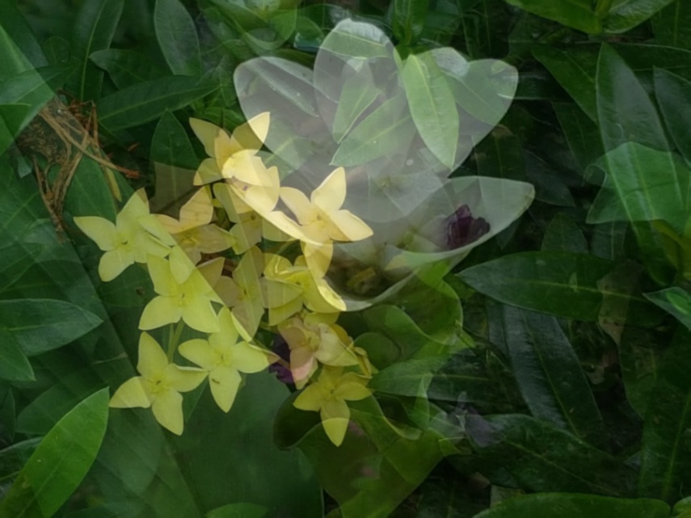
Blending and writing a file
from PIL import Image
try:
im = Image.open("flower04.jpg")
im01 = Image.open("flower05.jpg")
except IOError as err:
print("unable to load image")
#blend
im_bl=Image.blend(im, im01, 0.5)
im_bl.show()
im_bl.save('im_blend.jpg')
2개 파일의 모드와 픽셀 크기가 동일해야 한다
3번째 값은 2개 파일 블렌드 되는 정도

Slide 4
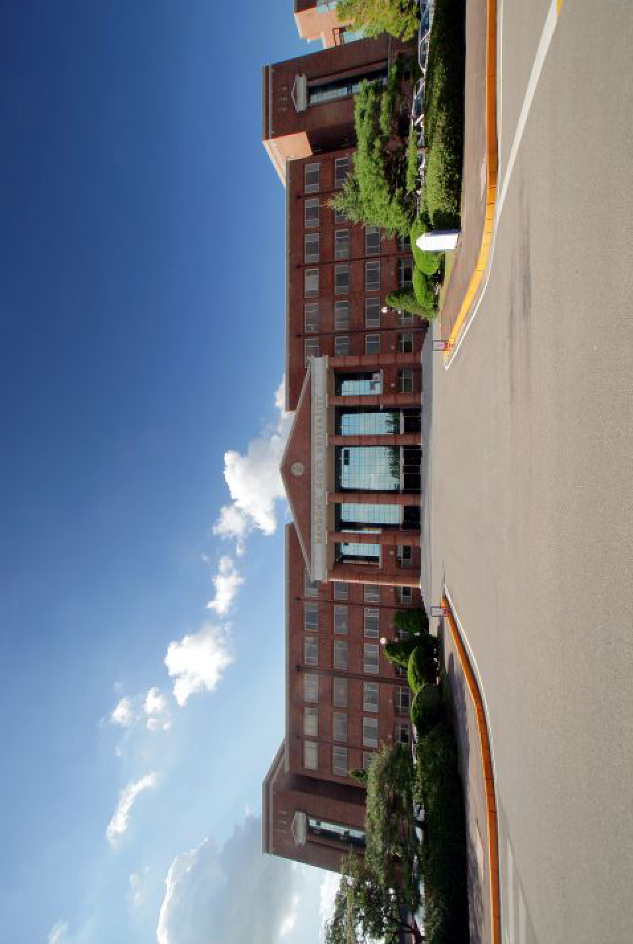

Cutting, transposing, pasting 1
from PIL import Image
try:
img = Image.open("./handong.jpg")
except IOError as err:
print(“파일을 열 수 없습니다.”)
img.show()
crop_img = img.crop((50,50,200,200))
crop_img.show()

Slide 5
Cutting, transposing, pasting 2
from PIL import Image
try:
img = Image.open("./handong.jpg")
except IOError as err:
print(“파일을 열 수 없습니다.”)
trans_img = img.transpose(Image.ROTATE_90)
trans_img.show()

Slide 6

Cutting, transposing, pasting 3
from PIL import Image
try:
img1 = Image.open("./handong.jpg")
img2 = Image.open("./dog.jpg")
except IOError as err:
print(“파일을 열 수 없습니다.”)
Image.paste(img1, img2, (50, 125))
img1.show()

Slide 7
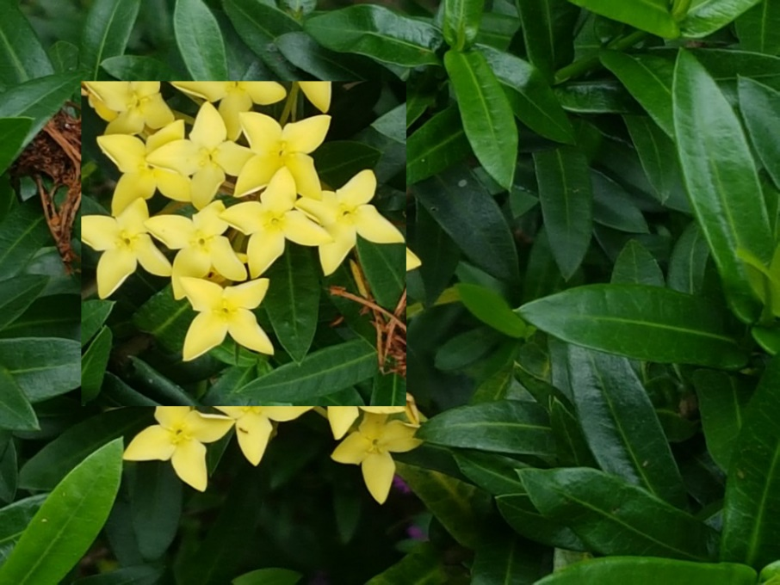
Cutting, transposing, pasting 4
from PIL import Image
try:
im = Image.open("flower04.jpg")
except IOError as err:
print("unable to load image")
# crop, tranpose, paste
box1 = (100,100,500,500)
region1 = im.crop(box1)
region1 = region1.transpose(Image.ROTATE_180)
im.paste(region1, box1)
im.show()

Slide 8
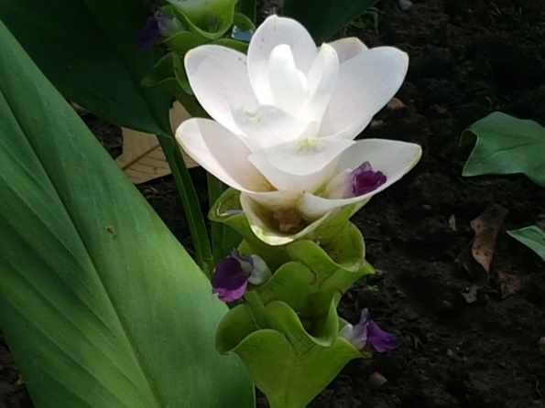
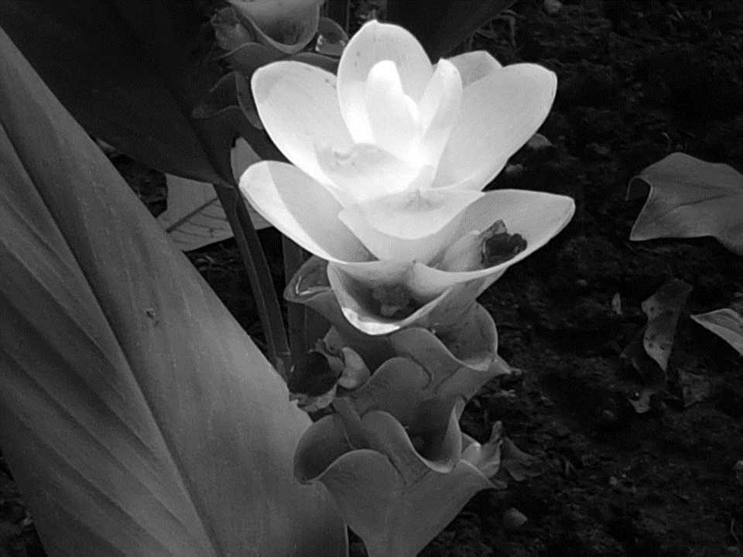
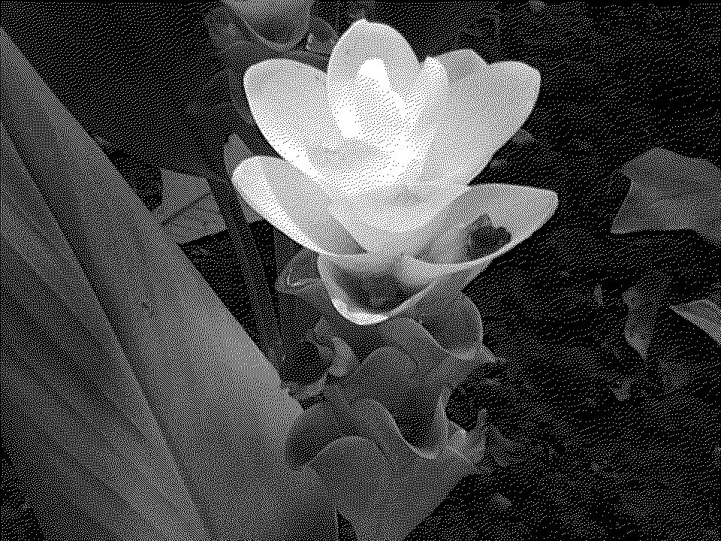
Color transforms 1
from PIL import Image
try:
im01 = Image.open("flower05.jpg")
except IOError as err:
print("unable to load image")
im01.show()
im_L = im01.convert("L")
im_L.show()
im_R = im01.convert("1")
im_R.show()

Slide 9
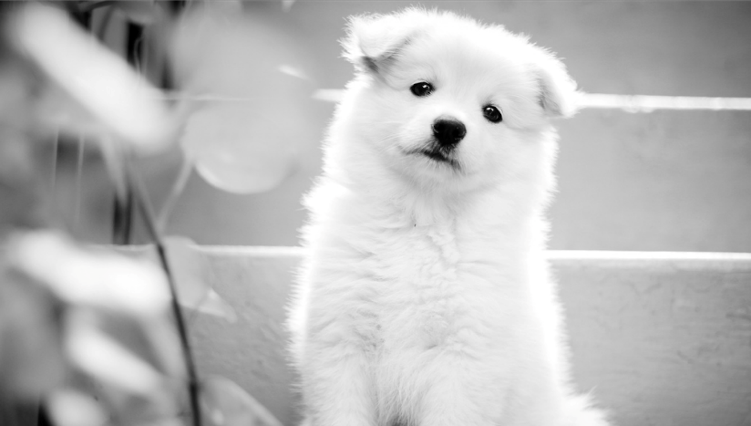
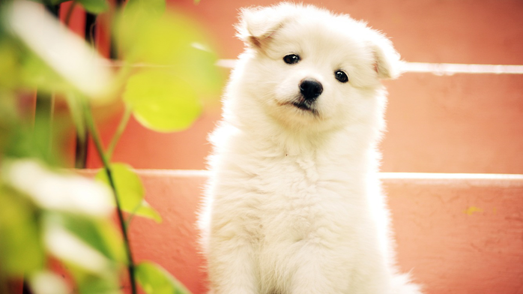
Color transforms 2
from PIL import Image
try:
img1 = Image.open("./dog.jpg")
except IOError as err:
print("unable to load image")
convert_img1 = img1.convert('L')
convert_img2 = img1.convert('RGB')
convert_img1.show()
convert_img2.show()

Slide 10
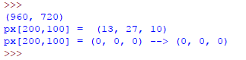

Access pixel
# show RGB value on a point
from PIL import Image
try:
im = Image.open("flower05.jpg")
except IOError as err:
print("unable to load image")
print(im.size)
px = im.load()
print ('px[200,100] = ', px[200,100])
px[200,100] = (0,0,0)
print ('px[200,100] = (0, 0, 0) -->', px[200,100])
im.show()

Slide 11
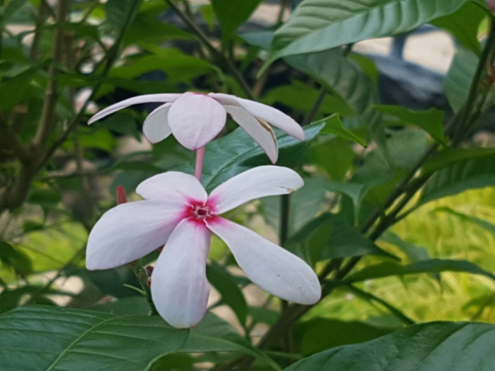
ImageEnhance Module(1)
from PIL import Image, ImageEnhance
try:
im01 = Image.open("flower01.jpg")
except IOError as err:
print("unable to load image")
enhancer = ImageEnhance.Sharpness(im01)
factor = 1 / 4.0
enhancer.enhance(factor).show("Sharpness", factor)

Slide 12
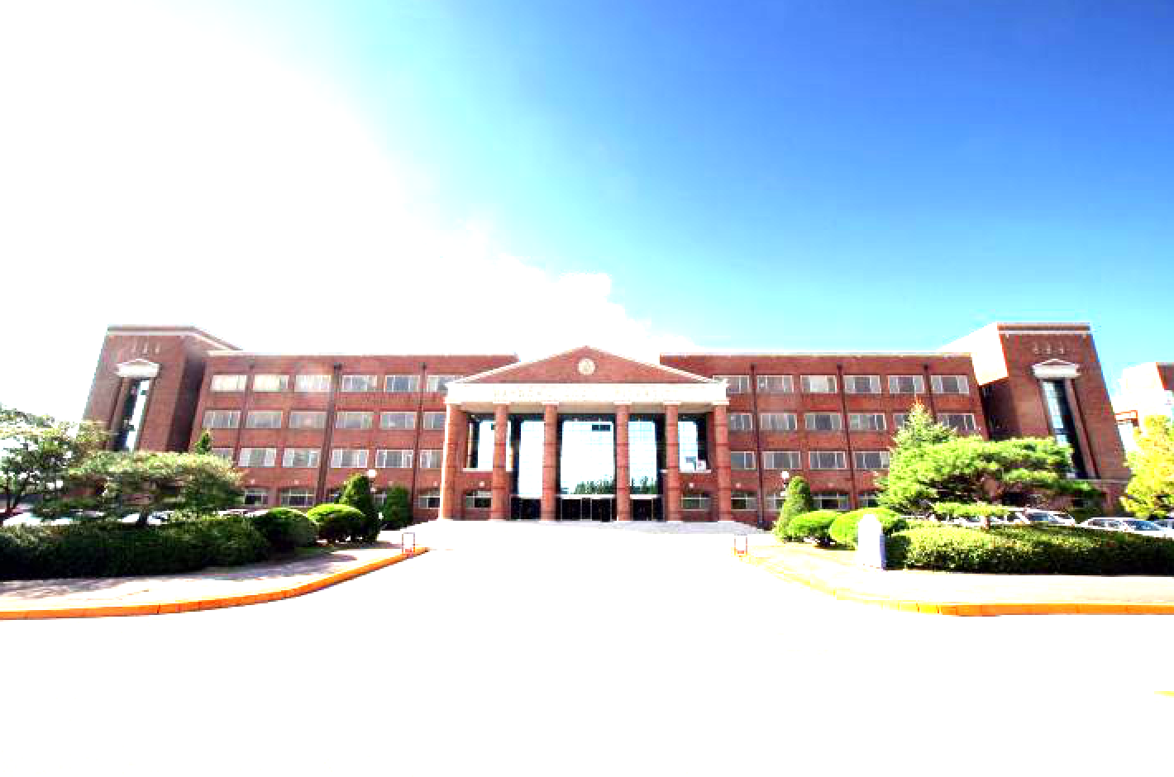
ImageEnhance Module(2)
from PIL import Image
from PIL import ImageEnhance
try:
img = Image.open("./handong.jpg")
except IOError as err:
print("unable to load image")
enhance_img = ImageEnhance.Brightness(img)
enhance_img.enhance(2).show()

Slide 13
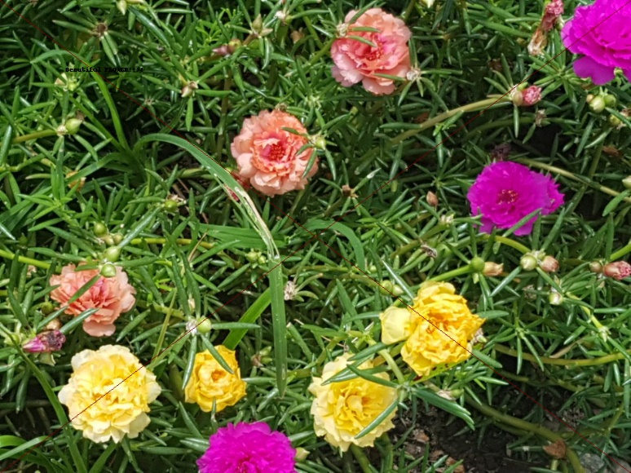
ImageDraw Module(1)
from PIL import Image, ImageDraw
try:
im01 = Image.open("flower02.jpg")
except IOError as err:
print("unable to load image")
draw = ImageDraw.Draw(im01)
draw.line((0, 0) + im01.size, fill=128)
draw.line((0, im01.size[1], im01.size[0], 0), fill=128)
draw.text((100, 100), "Beautiful FLOWER!!!!", fill=0)
im01.show()

Slide 14

ImageDraw Module(2)
from PIL import Image, ImageDraw
try:
base = Image.open("flower01.jpg").convert('RGBA')
except IOError as err:
print("unable to load image")
txt = Image.new('RGBA', base.size, (255,255,255,0))
d = ImageDraw.Draw(txt)
# draw text, half opacity
d.text((30, 80), "GOOD MORNING!!!", fill=(255,255,255,128))
# draw text, full opacity
d.text((30, 100), "Everybody", fill=(255,255,255,255))
out = Image.alpha_composite(base, txt)
out.show()

Slide 15
연습문제 1
좋아하는 사진을 open 한다
Crop 기능을 활용하여 사진의 일부를 90도 돌린다
사진을 합쳐서 출력한다

Slide 16
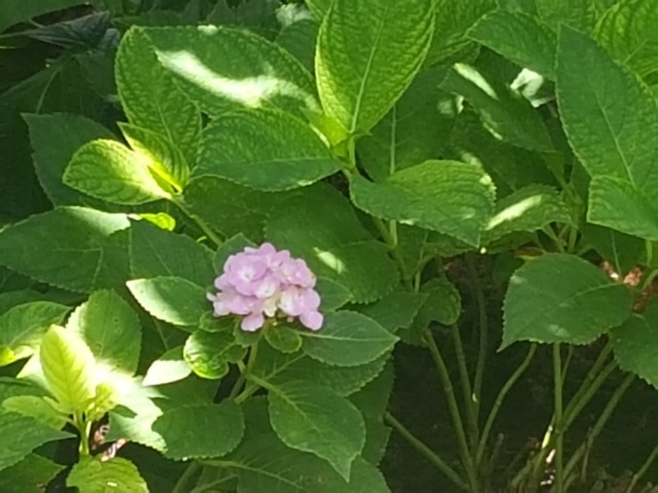
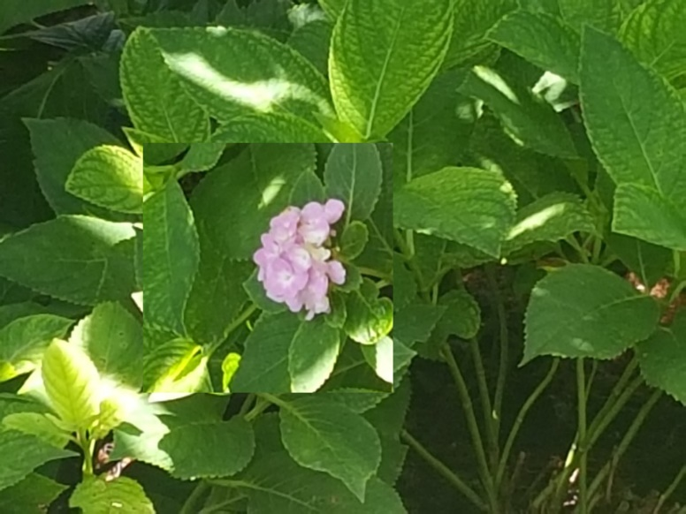
연습문제 1 코드
from PIL import Image
try:
im = Image.open("flower06.jpg")
except IOError as err:
print("unable to load image")
im.show()
box1 = (200,200,550,550)
region1 = im.crop(box1)
region1 = region1.transpose(Image.ROTATE_90)
im.paste(region1, box1)
im.show()

Slide 17
강의 요약
Pillow 명령어 활용
.blend()
.transpose()
.convert()
.Sharpness()
.crop()
.line()
.text()

Slide 18
목표 달성 질문
이미지를 열어서 그림 내에 일정한 텍스트를 쓰려면 어떤 명령어를 사용해야 하는지 기술하시오
이미지를 열어서 그림 내에 일정한 공간을 잘라내는데 어떤 명령어를 사용하는가?

Slide 19
감사합니다
13주차_01_02 Pillow기본 명령어 활용

